Slide 1
Audits and Inspections for Law Enforcement

Slide 2
Law Enforcement Auditing
Introductions
  Name
  Rank
  Agency and number of sworn
  What audits and inspections do you do now?
  Why are you here?

Slide 3
Law Enforcement Auditing
Why Audit?

Slide 4
Law Enforcement Auditing
Recent Headlines
  • Audit finds HPD poses' substantial risk' to the city it serves.
  • BPD failed to monitor excessive overtime or institute promised reforms, state auditor finds.
  • Internal Audit at FPD Reveals Outside Work Violations.
  • Internal Audit Uncovers Misconduct in BPD.
  • Audit finds SPD has a backlog of untested rape kits.
  • Audit Identifies 'Major Gaps' In MPD Data Collection.
  • Audit of HPD Narcotics found 404 errors in more than 200 cases involving two officers.
  • OPD under-reported uses of force, especially on people of color, audit finds.
  • FPD Audit Faults Response Times, 911 Issues.

Slide 5
Law Enforcement Auditing
Why do we need to do Audits?
  Effectiveness and Efficiency
  Crime Control Strategies
  Accountability
  Policy and Procedure Compliance
  Transparency and Public Trust
  Training and Development
  Citizen Satisfaction

Slide 6
Law Enforcement Auditing
Why do we need to do Audits?
  What are some recent failures in Law Enforcement?
  Memphis Police Scorpion Unit
  Louisville Police – Breona Taylor
  Uvalde, Texas
  DOJ Investigations/Lawsuits/Consent Decrees
  Houston PD Lack of Investigations

Slide 7
Law Enforcement Auditing
Why do we need to do Audits?
  Improve safety procedures
  Identify equipment malfunctions
  Correct process failures (example: warrant affidavits, warrant executions, use of force, arrests)
  Improve Case Management
  Auditing lets people know you are watching!
  Auditing lets people know you care!

Slide 8
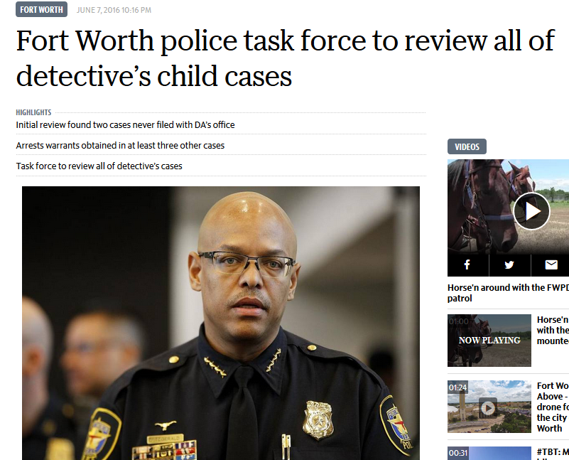
Law Enforcement Auditing
Notes:
Joel Fitzgerald

Slide 9
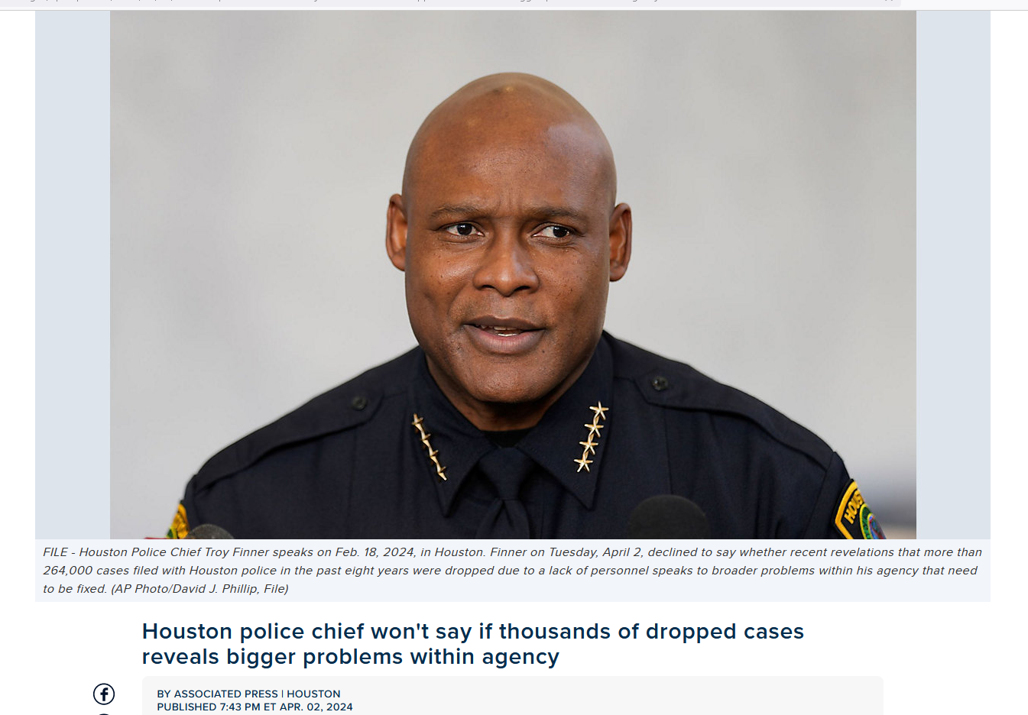
Law Enforcement Auditing
Notes:
Joel Fitzgerald

Slide 10
Law Enforcement Auditing
Why do we do Audits?
  The most famous Maxim in the auditing field is "Don't Expect what you Don’t Inspect."
  Because of the basic human desire to simplify tasks, everyone is tempted to develop shortcuts and eliminate steps they see as unnecessary. This becomes quite dangerous when critical legal or safety steps are skipped or not completed.
  Officers are subject to “Noble Cause” corruption because of their desire to perform well.

Slide 11
Law Enforcement Auditing
Why do we do Audits?
  Supervisors regularly monitor and examine individual officer performance. This is the supervision of personnel.
  Auditing is the supervision of department processes, operations and results.
  We can be very efficient, but not very effective…
  Do citizens want us to be effective?
  Does the media expect us to be effective?

Slide 12
Law Enforcement Auditing
Why do we do Audits?
They let people know you are watching… that what you are auditing is important and will be checked…
Discourages unauthorized modification…

Slide 13
Law Enforcement Auditing
Challenges in Smaller Agencies
Availability of accurate or quality data
Lack of Training
Limited Resources
Fear of Consequences

Slide 14
Law Enforcement Auditing
What is Auditing

Slide 15
Law Enforcement Auditing
  In simple terms, an audit is a thorough check or examination of an operation to ensure it is accurate, honest and follows the appropriate rules or procedures.
  It is a detailed review of information or data collected over time to assure department leadership that everything works as it should.
  Auditing provides confidence to our leaders and our communities that we are operating appropriately.

Slide 16
Law Enforcement Auditing
So…
  Examining department operations in detail.
  Comparing what is really happening to what should be happening.
  Identifying Best Practices.
  Identifying weaknesses and correcting them.
  Based on the evidence – not opinion, belief, or conjecture.
  Auditing is SUPERVISION!

Slide 17
Law Enforcement Auditing
Audit or Inspection?
  Audits are typically periodic, structured in-depth looks at an operation. They are used to determine if all of the details of an operation are being performed properly. They usually look at things over time.
  Inspections are usually more routine, informal, and a single looks at an operation to ensure things are still working properly. They are usually more regular and superficial. Are things working right now…
  Both are needed!

Slide 18
Law Enforcement Auditing
  Types of Audits
  Administrative
  Operational
  Performance
  Accountability
  Audits frequently are combinations of the above types.

Slide 19
Law Enforcement Auditing
Types of Audits
  Administrative: Examining the internal operations of the department with employees and operations that affect the entire department.
    Financial audits
    Information Technology (TLETS, Passwords, etc.)
    Training and Development
    Staffing levels
    Crime Control Effectiveness

Slide 20
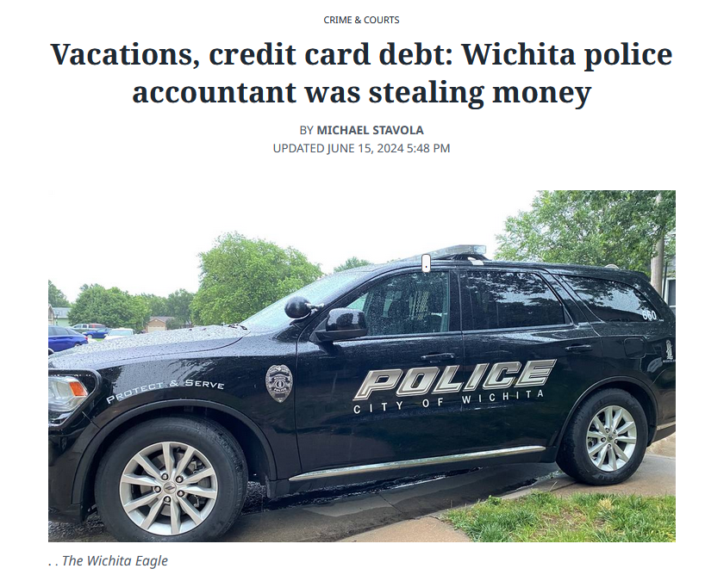
Law Enforcement Auditing

Slide 21
Law Enforcement Auditing
Types of Audits
  Operational: Examining departmental law enforcement operations as they are exercised in our community.
    Use of force
    Vehicle and Foot Pursuits
    DWI Enforcement
    Field Supervision
    Traffic Stops

Slide 22
Law Enforcement Auditing
Types of Audits
  Performance: Are our operations achieving the objectives? (Outcomes)
    Crime Reduction
        Effectiveness of Patrol Hot Spot Activity
    Accident Reduction
    Response Time
    Detective clearance rates
    Effectiveness of Misdemeanor Drug Arrests

Slide 23
Law Enforcement Auditing
Types of Audits
  Accountability: The review of activities and internal controls to ensure they provide integrity, fairness, and the prevention of bias in policing.
    Racial Profiling
    Arrests by Type and Race
    Supervisor Body Camera reviews
    Required reviews of COC arrests (LAPD)
    Ethics and Integrity Audits
    Warrant or Arrest Accuracy Audits

Slide 24
Law Enforcement Auditing
Essential Features of Audits
  They are pre-planned and methodical in nature rather than haphazard.
  They should be free from bias or prejudice.
  They encompass some form of inquiry and critical consideration of the resulting findings.
  They should ensure that activities are carried out in an effective and consistent manner in accordance with policy of department.
  They provide proof of finding with actual data.

Slide 25
Law Enforcement Auditing
What is Data?
Data is whatever you are looking at to answer your questions.
    Copies of all use of force reports for two years
    The investigative notes module of the case management system
    All arrest reports with injured prisoners

Slide 26
Law Enforcement Auditing
Where do you get Data?
Specific to your department:
CAD Dept. Video CID Files
RMS Payroll Records Training Records
JMS IAD Records Spec. Unit Files
Admin Files State Website Court Websites

Slide 27
Law Enforcement Auditing
How often do you Audit?
Depends on Risk and Control Systems in place.
High Risk Issue - First time – Full Audit
  Identifies weaknesses, corrects policy or operation.
  Develops continuous control mechanisms and monitoring systems.
  Future audits just tests control and monitoring systems.

Slide 28
Law Enforcement Auditing
Potential Disadvantages of Audits…
  Audits are costly in the time required.
  In smaller departments they usually require a paid staff member to do something that is not their primary job, a job that directly benefits the citizens.
  However, in the long run, the citizens usually benefit by ensuring that operations are being conducted properly.

Slide 29
Law Enforcement Auditing
Potential Disadvantages of Audits…
  Audits may cause disharmony in the agency
  Restrict results to improvements rather than discipline (unless criminal).
  Multiple omissions or continued failure may need to result in corrective action.

Slide 30
Law Enforcement Auditing
How to Prevent Disharmony due to Audits
Chief should clearly explain purpose of audit is not to find fault but to improve operations.
No disciplinary action will be taken (unless criminal).
Unit Supervisor/Commander will have first review and comment of audit report.

Slide 31
Law Enforcement Auditing
What to Audit

Slide 32
Law Enforcement Auditing
What do we need to Audit?
Actions or omissions in your department that place officers and citizens at risk of injury or death
Things that are required of the department to properly manage, such as cash accounts and information security, and equipment
Other items identified in a Risk Assessment

Slide 33
Law Enforcement Auditing
What is a Risk Assessment?
Detailed analysis of department operations that will identify significant or major risks…
  The two primary questions to consider when evaluating the risk are:
    What is the probability that things can go wrong? (the likelihood of any one event)
    What is the cost if what can go wrong does go wrong? (the exposure of one event)

Slide 34
Law Enforcement Auditing
Steps in Risk Assessment
Step 1: Identify critical assets, operations, and stakeholders.
Step 2: Brainstorm potential threats to these assets, operations, or people.
Step 3: Determine “Likelihood” of threat. (1-5)
Step 4: Determine potential consequences if that were to happen. (1-5)

Slide 35
Law Enforcement Auditing
Steps in Risk Assessment
Step 5: Compute Relative Risk (Step 3 multiplied by step 4)
Step 6: Determine if audit needed or conduct Threat Mitigation activities.

Slide 36
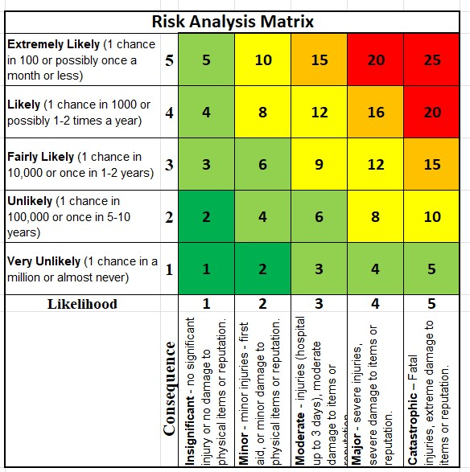

Slide 37
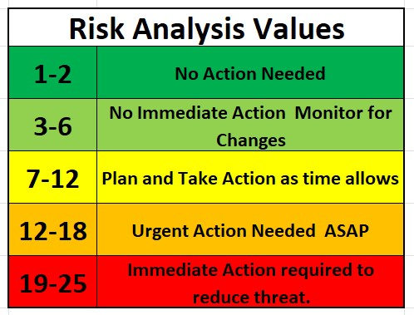

Slide 38
Law Enforcement Auditing
Threat Mitigation Steps:
1. Eliminate the Operation.
2. Substitute a less dangerous activity/operation.
3. Apply engineering solution.
4. Apply and Administrative Solution
5. Provide personnel with PPE, training, or equipment.

Slide 39
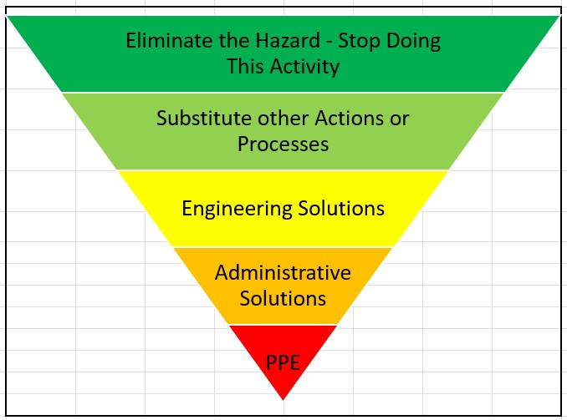

Slide 40
Law Enforcement Auditing
How to Audit

Slide 41
Format of Audit
Purpose:
Background:
Methodology:
Findings:
Recommendations:
Actions Taken:

Slide 42
Purpose:
States the reason you are conducting an audit, who ordered it, and what you are attempting to determine.
Background:
Refers to any prior audits and if there were any significant findings in prior audits, or if there are any important historical, political, societal, or departmental reasons for conducting the audit.

Slide 43
Methodology:
Explains how you conducted your audit:
  Sample size, sample population, and how sample was selected,
  Date range of sample,
  The data sources that were drawn from,
  Explains what you may have chosen to exclude.

Slide 44
Findings:
  Summary of Findings: describes most important issues of non-compliance in broad terms. (20 percent of arrest reports were not signed by a supervisor.)
  Detailed Findings: lists the specific reports, incidents, or documents not in compliance.

Slide 45
Recommendations:
Must be a result of specific findings from this audit, driven by deficiencies or best practices identified in the audit.
Actions Taken:
When you can fix things identified in the audit that will remedy deficiencies or highlight successes, do so!

Slide 46
Law Enforcement Auditing
Who should do the Audits in your Agency?
    Because individuals seldom find fault with themselves or the operations which they designed, operations should never be audited by the person doing that job.
    While supervisors of operations might be able to conduct an independent audit, the fact that they are personally responsible for seeing that employees under their command comply with the policy could result in not identifying or reporting instances of failure.

Slide 47
Law Enforcement Auditing
Who should do the Audits in your Agency?
  Some suggestions on who might conduct the audits within your agency:
    The Chief of Police
    Command or Supervisor from another operational area
    Any supervisor
    A Reserve officer
    Manager or supervisor from another City Department
    Citizen's Academy volunteer

Slide 48
Law Enforcement Auditing
Who should do the Audits in your Agency?
  Code of Ethics for Internal Auditors in Government
    Integrity
    Objectivity
    Competency
    Confidentiality
    Independence

Slide 49
Law Enforcement Auditing
The Audit Process
The entire audit process can be described as
  Planning
  Executing (Fieldwork)
  Reporting

Slide 50
Law Enforcement Auditing
Steps in the Audit Process
  Determining Questions to be Answered
  The Assignment of the Audit
  Development and approval of an Audit Plan
  Entrance Conference
  Fieldwork
  Draft Report
  Exit Conference
  Final Audit Report

Slide 51
Law Enforcement Auditing
Determining the Questions to be Answered
Usually done by the person assigning the audit
This determines what data will need to be reviewed
Possible Audit questions in Reference materials

Slide 52
Law Enforcement Auditing
The Audit Process
Assignment of the Audit
  Select the person(s) to conduct the Audit
  Notify the person(s), give time frame
  Require review of training materials and Audit Manual
  Notify unit supervisor of unit being Audited

Slide 53
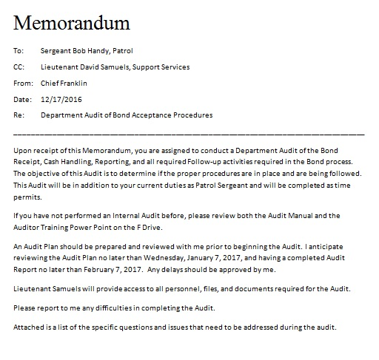
Law Enforcement Auditing
The Audit Process
Assignment of the Audit

Slide 54
Law Enforcement Auditing
The Audit Process
Planning the Audit
  Objective of audit
  Scope (What do you want the audit to cover)
  Timing of Audit
  Comparison departments and Best Practices to be reviewed
  Chief review to ensure all issues covered before audit

Slide 55
Law Enforcement Auditing
The Audit Process
Planning the Audit
  Set up Entrance Conference and Initial Walkthrough with Unit Supervisor
  Data to be reviewed including minimum number of internal documents
  Review any prior audits of same function
  Interviews to be conducted
  Are Double checks of Data required

Slide 56
Law Enforcement Auditing
The Audit Process
Entrance Conference
  Ensure clear understanding of purpose and scope
  Ensure supervisor aware of review before submission
  Request assistance in access
  Ask if unit supervisor wants anything else reviewed
  Determine least disruptive times to audit

Slide 57
Law Enforcement Auditing
The Audit Process
Fieldwork
  Consider using flowcharts – chart what policy says to do, then chart what is actually done.
  Make copies of logs and documents that may be discussed in the audit report
  Use sampling process for sampling of large number of documents:
    Ensure all shifts/personnel covered in audit
  Ensure all audit questions are covered

Slide 58
Law Enforcement Auditing
The Audit Process
Two Types of Sampling
Statistical
Non-Statistical

Slide 59
Law Enforcement Auditing
The Audit Process
Statistical sampling
  Gives mathematical credibility to audit
  For sampling to be valid, all statistical samples must be random
  Any random process will work
  Random Sampling Processes in Reference Materials
  Must stick with plan to be credible

Slide 60
Law Enforcement Auditing
The Audit Process
Random Sampling
  Call IT
  Systematic Sampling (every Nth item)
  Stratified Sampling (proportional to presence in data)
  Cluster Sampling (random cluster, all sampled)
  Online Tools

Slide 61
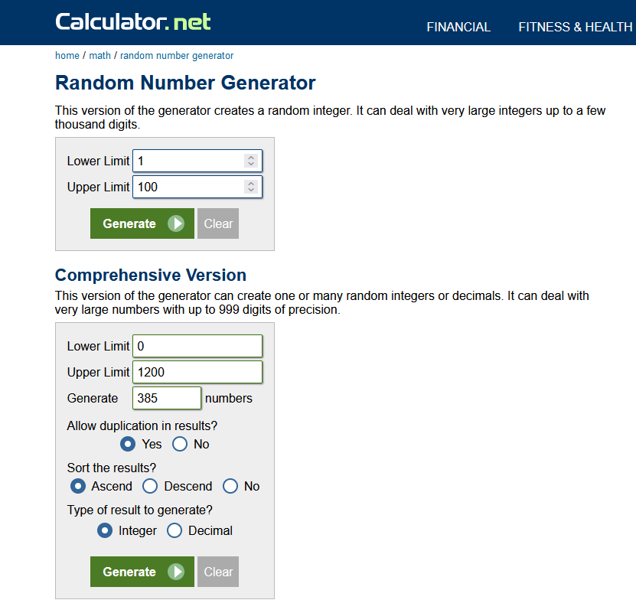
Law Enforcement Auditing
The Audit Process

Slide 62
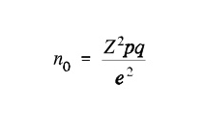
Law Enforcement Auditing
The Audit Process
Statistical sampling
  How many is enough?
  Statistical Sampling to get 95% Confidence level
  Formula to determine sample size is:

Slide 63
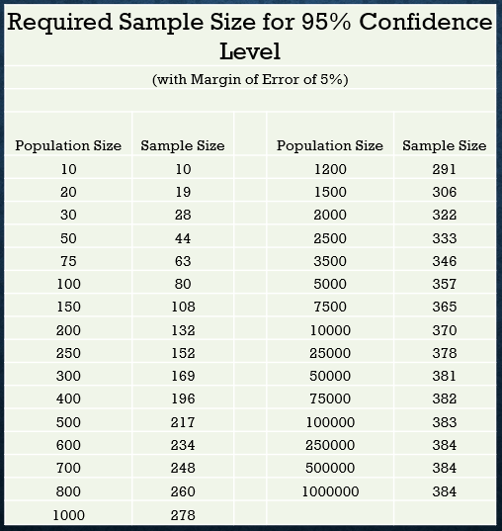
Law Enforcement Auditing
The Audit Process

Slide 64
Law Enforcement Auditing
The Audit Process
Non-Statistical sampling
  Random Sampling
  Fixed Interval
  Value-Weighted
  Block Selection
  Stratified Sampling

Slide 65
Law Enforcement Auditing
The Audit Process
  Documentation:
    Keep log of all items reviewed, actions taken, interviews conducted and results
    Copies of all exceptions (to be included in final report)
    Don’t skimp in data collection

Slide 66
Law Enforcement Auditing
The Audit Process
  Analysis of Results
  State facts and not opinions
  Be careful of confusing Correlation and Causation…

Slide 67
Law Enforcement Auditing
The Audit Process
Draft Report (Not all Audits require formal reports)
  Use pre-formatted Report or your own design
  Describe the function process in detail
  Summarize findings
    Comparison to other cities and best practices
    Finding of internal review
  Detail of any failures in procedure or operations
  Detail of any management oversight failures
  Recommendations and future control methods

Slide 68
Law Enforcement Auditing
The Audit Process
Exit Conference
  Provide draft report to Unit Supervisor
  Clear review and response period
  Responses obtained / issues clarified

Slide 69
Law Enforcement Auditing
The Audit Process
Final Report
  Management Responses added after each detailed issue
  Formatted as needed / spell checked
  Copies of attachments added
  Report and work papers submitted.

Slide 70
Law Enforcement Auditing
The Audit Process
Follow-up
  Chief of Police is responsible for assigning or conducting follow-up activities
  Should schedule follow-up inspection to ensure completions and compliance
  Not all findings must be addressed

Slide 71
Law Enforcement Auditing
The Audit Process
What gets inspected, gets Done!
Don’t Expect what you don’t Inspect!

Slide 72
Law Enforcement Auditing
Setting Up and Audit Schedule
Depends on Size of Department
Depends on resources
Depends on Risk
The chief determines the Audit Schedule

Slide 73
Law Enforcement Auditing
Your Departmental Audit Plan… (overall plan)
  Risk Assessment and Department problems first
  Determine how you can audit (Special audit, monthly report, after action, checklist)
  Resource Availability (who can do audits)
  Identify Audits to be conducted
  Determine frequency
  Schedule throughout year
  Find and assign personnel to conduct

Slide 74
Law Enforcement Auditing
Setting Up and Audit Schedule
Group Discussion – What are our highest risks?
  Admin Support
  Operations Cash Handling
    Patrol Property
    Investigations Equipment
    Special Ops
  What got Officers/Citizens Hurt or damaged Dept?
  What got Chiefs Fired?

Slide 75
Law Enforcement Auditing
Examples

Slide 76
Law Enforcement Auditing
Examples of Administrative Audits
  Overtime Use / Time Reporting
  Special Weapons and Equipment
  All department weapons
  Petty Cash Funds / Confidential Fund
  Required Training / Qualifications
  Off-Duty Jobs
  Seized Assets
  Citizen/Employee Complaint process

Slide 77
Law Enforcement Auditing
Examples of Operational Audits
  Body Cam Reviews
      Required reviews of all arrests for COC arrests?
      Arrest Reports / Body Cam Reviews
      Use of Force / Body Cam and Car cam review
  Special Detail Compliance (Hot Spot)
  Traffic Enforcement Activity
  Scheduling Efficiency
  Case Management / Case Clearances
  Warrant Affidavit Veracity / Warrant Execution Process
  Special Unit Operations and Effectiveness

Slide 78
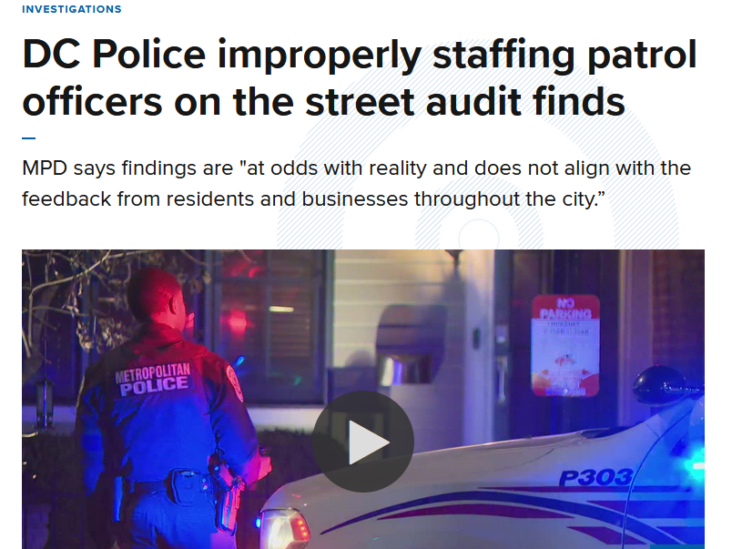

Slide 79
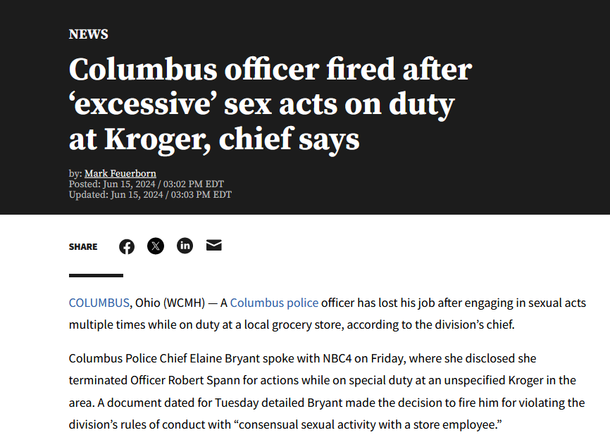

Slide 80
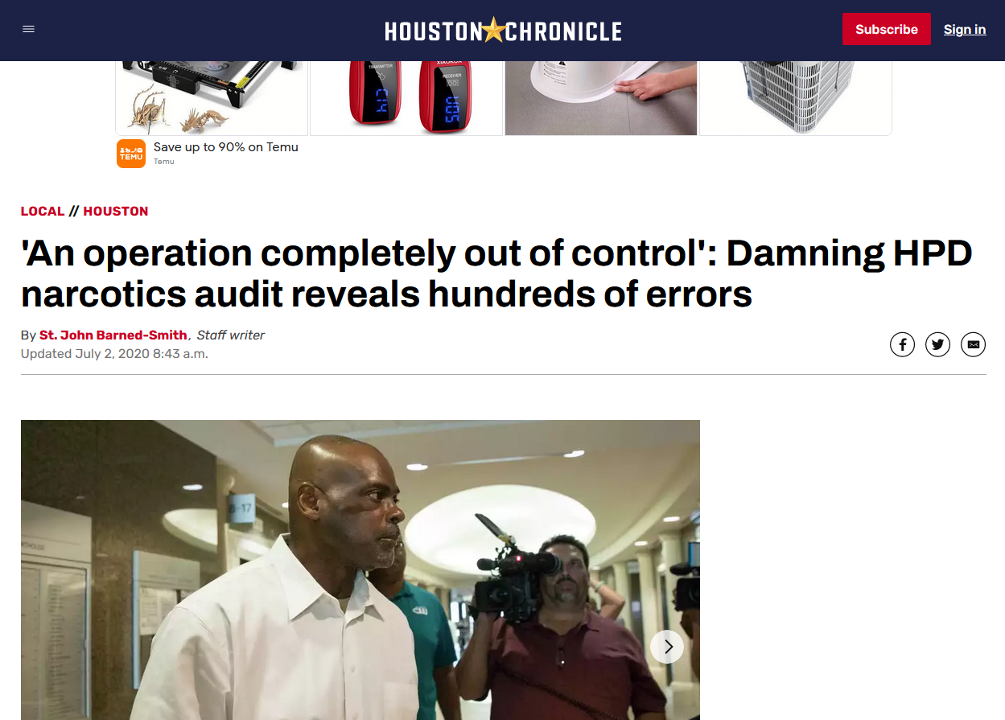

Slide 81
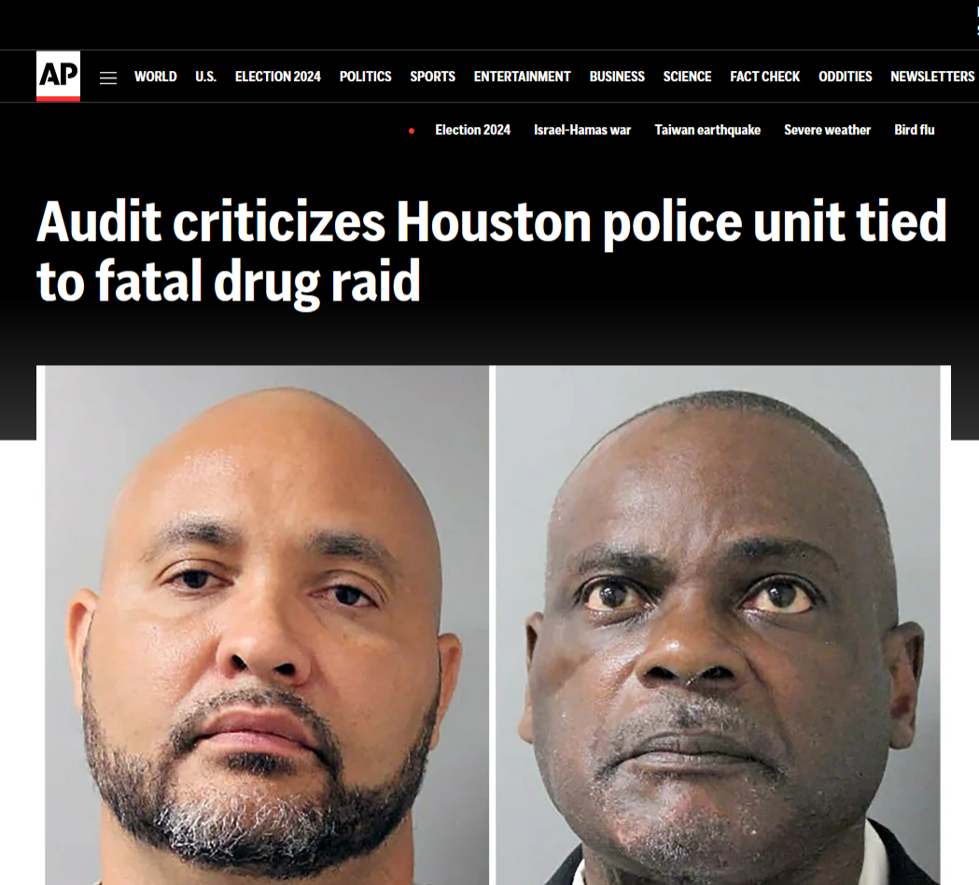

Slide 82
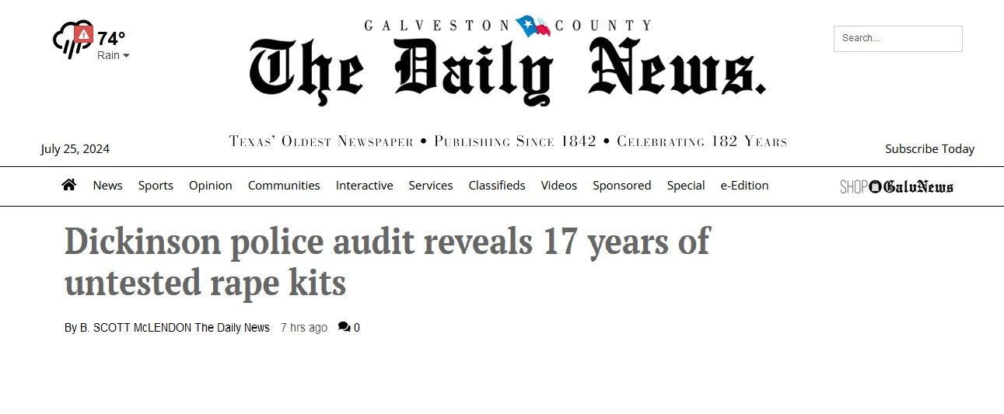

Slide 83


Slide 84
Law Enforcement Auditing
Examples of Performance Audits
  Crime Rate now and over time
  Response Time to Priority One Calls
  Department Clearance rate comparison to other similar cities and state average
  Accident rate over Time
  Citizen Satisfaction
  Increased Park and Public Space usage
  Increased attendance at Public Events

Slide 85
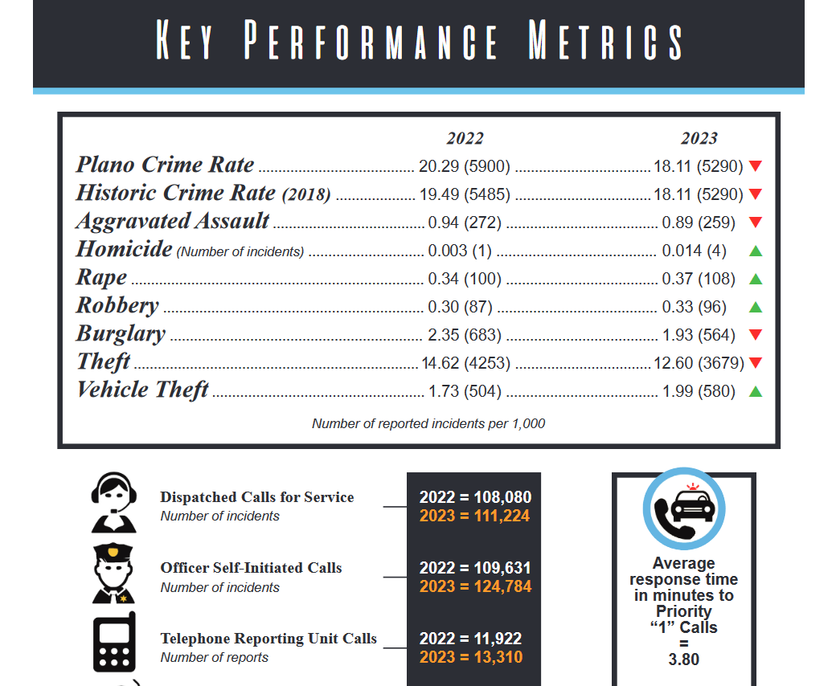
Law Enforcement Auditing
Examples of Performance Audits

Slide 86
Law Enforcement Auditing
Examples of Accountability Audits
  Racial Profiling
  Consent Searches
  Arrests by Type and Race
  Use of Pretext Stops
  Electronic Messaging

Slide 87
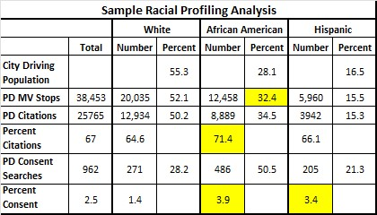
Law Enforcement Auditing
Examples of Internal Audits

Slide 88
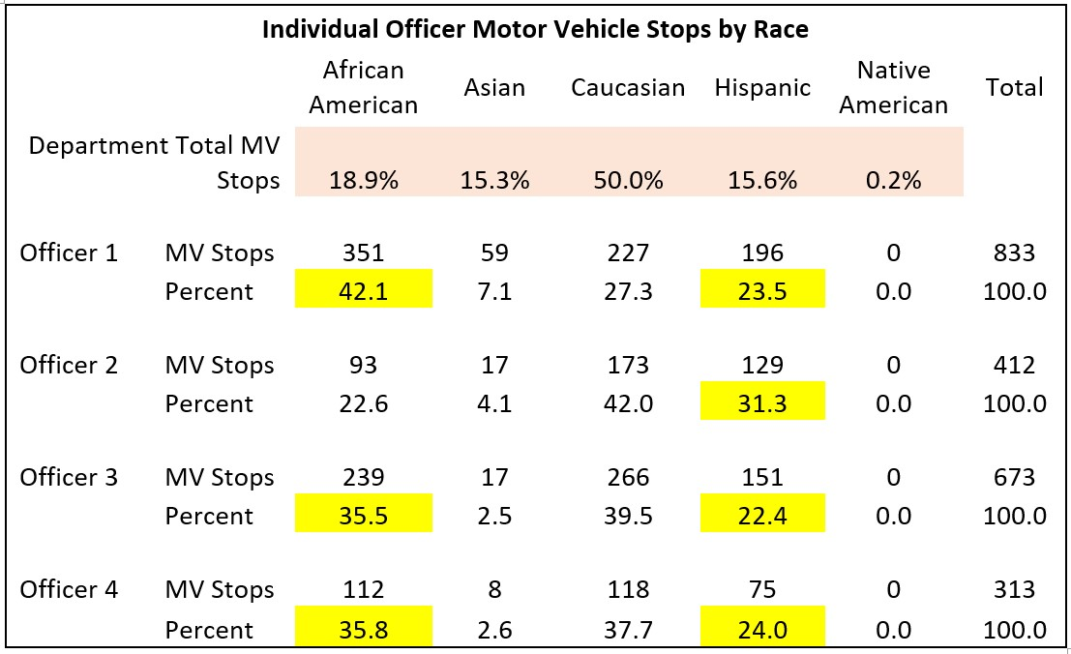
Law Enforcement Auditing
Examples of Internal Audits

Slide 89
Law Enforcement Auditing
Examples of CID Audits
Investigations
  Victim Interviews
  Case Clearances
  Case Documentation
  Case Closures (Open cases)
  Victim Satisfaction
  Cases Filed and Results
  Confidential Funds

Slide 90
Law Enforcement Auditing
Examples of Internal Audits
Specialized Units
  Arrest Body Cam Reviews
  Arrest Report / Body Cam confirmation
  Arrest and Citation Activity and location
  Affidavit Preparation
  High-Risk Warrant Service
  Cases Filed and Results
  Impact on Goals of Unit

Slide 91
Law Enforcement Auditing
What are some things that you can do for constant monitoring?
  Monthly/Quarterly Reports
  Automated Alerts/Reports
  Tracking data over time – trend examination
  After Action Reports
  Completion of Checklists
  Reviews of Specific Events

Slide 92
Law Enforcement Auditing
Specific Audit Questions?
Chief Jeffrey Bert (213) 804-3861
jeff.bert@shsu.edu

